Slide 1
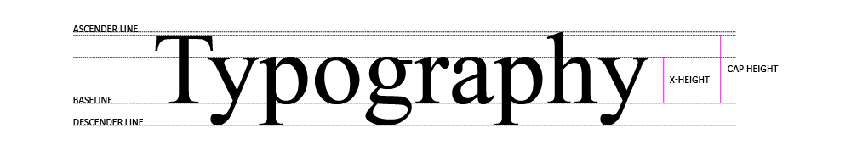
CSS & TYPOGRAPHY
CSS Text Properties, Fonts, Font Properties
SoftUni Team
Technical Trainers
Software University
https://softuni.bg

Slide 2
Table of Contents
Typography
Principles Of Readability
CSS Properties
Font Awesome Icons
Notes:
2

Slide 3
Have a Question?
sli.do
#html-css
Notes:
3

Slide 4
CSS Font Properties

Slide 5
What is Typography?
Typography is the art and technique of arranging type to make written language
Legible, readable and appealing
Typography is the visual component of the written word
5

Slide 6
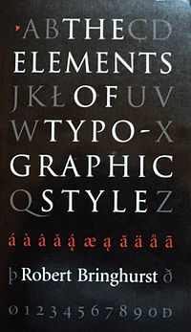
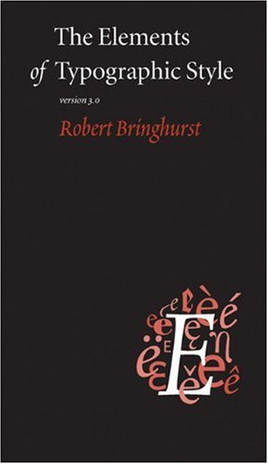
Books
The Elements of Typographic Style - the authoritative book on typography and style
The Elements of Typographic Style Applied to the Web - a practical guide to web typography
6

Slide 7
Principles of Readability
Readability is one of the most important aspects of Web design usability
Website readability is a measure of how easy it is for visitors to read and understand online text
Readability depends on both a text's presentation and its context
Poor readability scares readers away from the content

Slide 8
Keys to Readable Typography
User-Friendly Headers
White Space - scannable and consistent text
Emphasis of Important Elements
Good Margins to avoid walls of text
Scannable Text
Consistency
Organization of Information
8

Slide 9
Web Safe Fonts
Maximum compatibility between browsers/operating systems
Generic family fonts:
Font Name
Arial | Times New Roman
Courier New | Trebuchet MS
Georgia | Verdana

Slide 10
Font Files
Font files contain one or more fonts that can be accessed by the OS and applications
Most modern fonts are stored in the following formats:
OpenType (.OTF)
TrueType (.TTF)
Web Open Font Format (.WOFF)
Web Open Font Format 2 (.WOFF2)
10

Slide 11

Font Properties

Slide 12
Family Name
<family-name> - the name of a font-family
If a font name contains white-space, it must be surrounded by quotes
You can find a variety of fonts here
body {
font-family: "Times New Roman", serif;
}

Slide 13
@Font-face
Specifies a custom font with which to display text
The font can be loaded from either a remote server or a locally-installed font
@font-face {
font-family: "Open Sans";
src: url("/fonts/webfont.woff") format("woff");
}

Slide 14
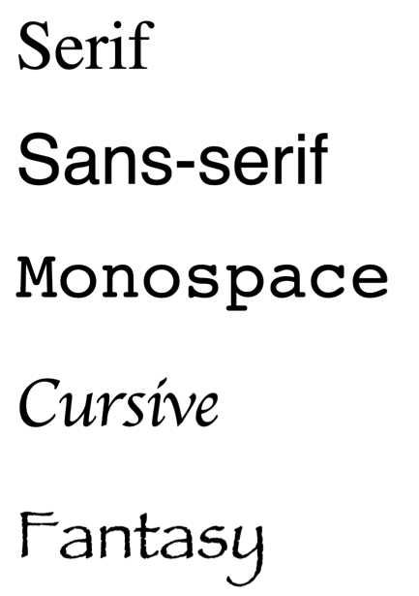
Generic Name
<generic-name> - a broad class of similar fonts used in a prioritized list of fonts
serif - all characters have stroke endings
sans-serif - no character has stroke endings
monospace - all characters have the same width
cursive - handwritten fonts
fantasy - decorative fonts

Slide 15
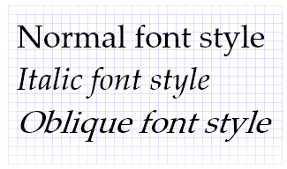
Font Style
font-style - defines how much the text is slanted
normal - the text is not slanted
italic - the letters are slightly slanted
оblique - the letters are more slanted than italic
font-style: normal;
font-style: italic;
font-style: oblique;

Slide 16
Font Size
Font-size - defines the text size
px values
The default font-size is 18px
rem values - the value is relative to the root's font-size
If font-size of the root element is 18px then 1 rem is 18px
font-size: 16px;
font-size: 1rem;

Slide 17
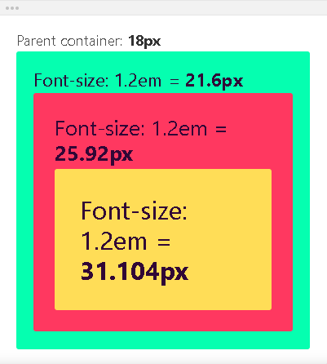
Font Size
em values - the value is relative
to the root's font-size
font-size: 1em;

Slide 18
Font Weight
font-weight - defines the weight (or boldness) of the text
Keyword values - such as bold or bolder
Numeric values - from 100 to 900
100 is thin, and 900 is bolder
font-weight: bold;
font-weight: bolder;
font-weight: 100;
font-weight: 900;

Slide 19
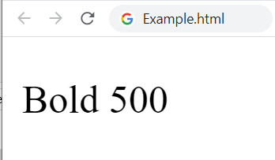
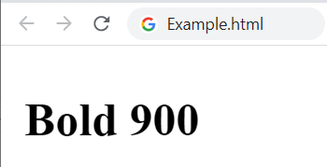
Font Weight (2)
font-weight with numeric values correspond to a particular named weight:
100 - Thin
200 - Extra Light
400 - Normal
700 - Bold

Slide 20
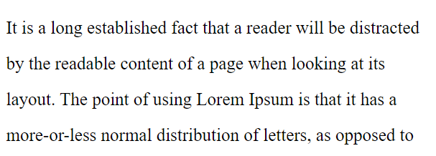
Line Height
line-height - defines the height of a single line of text
Unitless values - the line height will be relative to the font size
line-height: 1.5;

Slide 21
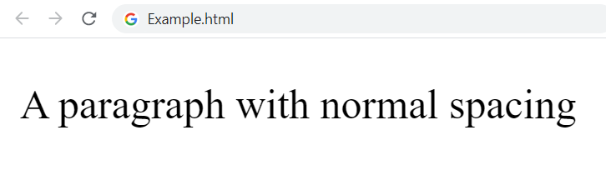
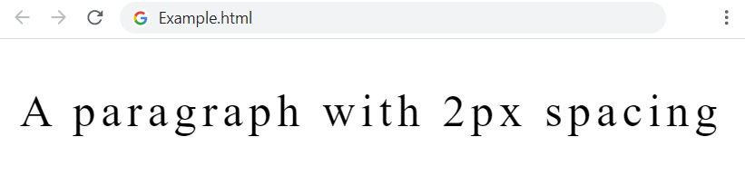
Letter Spacing
letter-spacing - defines the spacing between the characters of a block of text
normal - the spacing between the characters is normal
Using pixels
letter-spacing: normal;
letter-spacing: 2px;

Slide 22
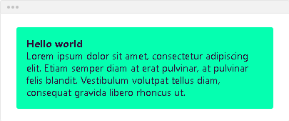
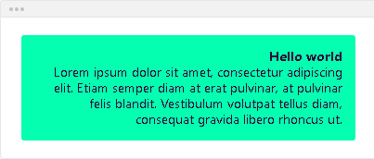
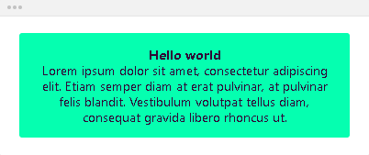
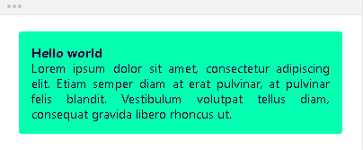
Text Align
text-align - defines how the content of the element is horizontally aligned
Property values: left, right, center, justify
text-align: center;

Slide 23

Text Decoration
text-decoration - defines how the text content of the element is decorated: overline, underline, line-through
none - removes any text decoration
line-through - draws a line across the text
text-decoration: none;
text-decoration: line-through;

Slide 24
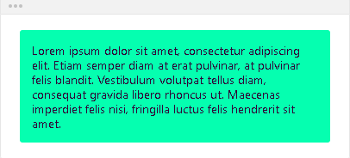
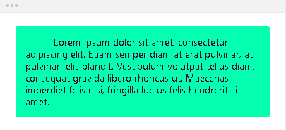
Text Indent
text-indent - defines the indentation of the element's first line of text
The text is not indented
The text is indented
text-indent: 0;
text-indent: 40px;

Slide 25
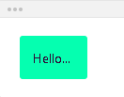
Text Overflow
text-overflow - defines how the hidden text content behaves if it's overflowing
ellipsis - the overflowing content is replaced by . . .
text-overflow: clip;

Slide 26
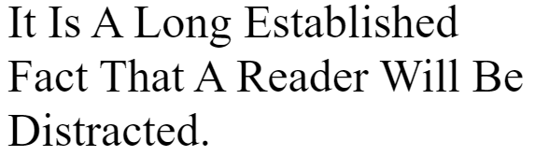
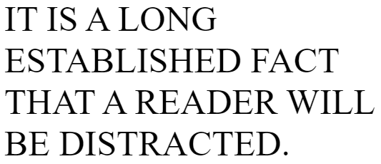
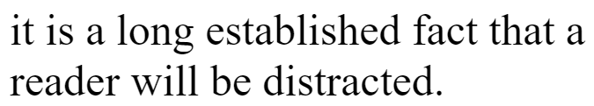
Text Transform
text-transform - specifies how to capitalize text
capitalize - turns the first letter of each word into a capital letter
uppercase - turns all characters to uppercase
lowercase - turns all characters to lowercase
text-transform: capitalize;
text-transform: uppercase;
text-transform: lowercase;

Slide 27


Word Break
word-break - defines how words should break when reaching the end of line
normal - words with no space will NOT break
break-all - words with no space will break as soon as they reach the end of a line
word-break: normal;
word-break: break-all;

Slide 28
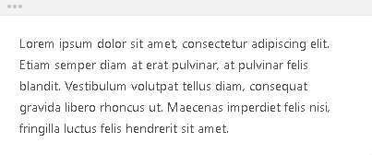
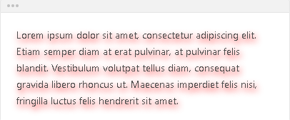
Text Shadow
Text-shadow - defines the shadow of the text content
None - the text content has no shadow
Text-shadow: <horizontal> <vertical> <blur> <color>
p {
text-shadow: none;
}
p {
text-shadow: 2px 4px 10px red;
}

Slide 29




Text Color
color - defines the color of the text
You can use one of the 140+ color names
You can use hexadecimal color codes
You can use rgb() color codes
You can use rgba() color codes
color: red;
color: #05ffb0;
color: rgb(125, 125, 255);
color: rgba(255, 0, 0, 0.5);

Slide 30
Background Color
background-color - defines the color of the background
transparent
Specify the background color with:
HEX
RGB/RGBA
Named color
background-color: transparent;
background-color: navy;

Slide 31


Cursor
Sets the mouse cursor when hovering the element
Pointer
Move
p {
cursor: pointer;
}
p {
cursor: move;
}

Slide 32

Outline
Outline
Outline-width - defines the width of the element's outlines
Outline-style - defines the style of the element's outlines
Outline-color - defines the color of the element's outlines
p {
outline: 4px dotted red;
}

Slide 33
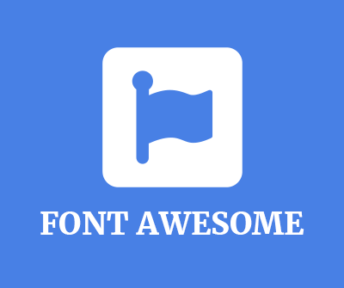
Font Awesome Icons

Slide 34
What is Font Awesome?
Icon fonts:
Fonts containing symbols and glyphs instead of letters / numbers
You can style them with CSS the same way as regular text
Font awesome is most popular icon toolkit based on CSS
More than 7,000 Awesome Icons
34

Slide 35
Getting Started with Font Awesome
To use the Font Awesome icons, add the following line inside the <head> section of your HTML file:
Import Font Awesome in the CSS file:
<link rel="stylesheet" href="https://use.fontawesome.com/releases/v5.10.2/css/all.css">
@import 'https://use.fontawesome.com/releases/v5.10.2/css/all.css';

Slide 36
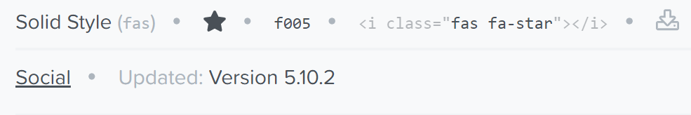

Font Awesome – Example
Choose an icon
Copy the <i> element
Paste it in your HTML file
<head>
<link rel="stylesheet" href="https://use.fontawesome.com/releases/v5.10.2/css/all.css">
</head>
<body>
<i class="fas fa-star"></i>
</body>

Slide 37

Summary
What is Typography?
The principles of readability
CSS properties: font-family, font-size, font-style, color, background
Font Awesome Icons
Notes:
37

Slide 38
Questions?
Notes:
38

Slide 39










SoftUni Diamond Partners

Slide 40



Educational Partners

Slide 41

License
This course (slides, examples, demos, exercises, homework, documents, videos and other assets) is copyrighted content
Unauthorized copy, reproduction or use is illegal
© SoftUni – https://about.softuni.bg/
© Software University – https://softuni.bg
Notes:
41

Slide 42
Trainings @ Software University (SoftUni)
Software University – High-Quality Education, Profession and Job for Software Developers
softuni.bg, about.softuni.bg
Software University Foundation
softuni.foundation
Software University @ Facebook
facebook.com/SoftwareUniversity
Software University Forums
forum.softuni.bg
42
Notes:
42

